Slide 1
SENTIMENTAL ANALYSIS on Customers Review
PRESENTED by –
VANGASAM KISHORE REDDY

Slide 2
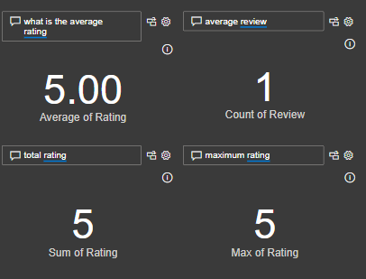
ORIGINAL DATA:
I'll assume the dataset contains a column for ratings. Since I cannot directly access image content, I will guide you through the process of calculating the required statistics and forming sentences based on the findings shows as Pic-1
Pic-1: Customers Review

Slide 3
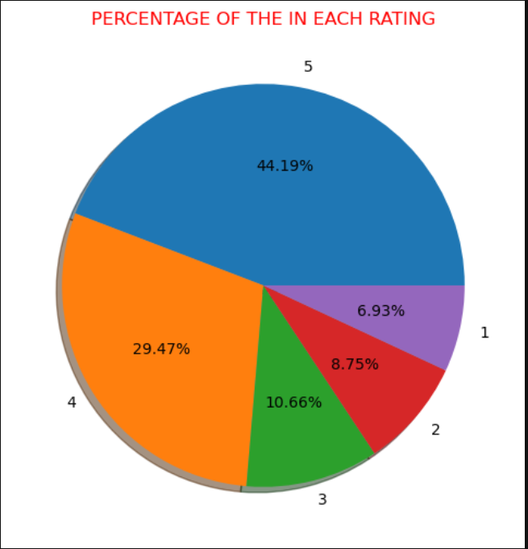
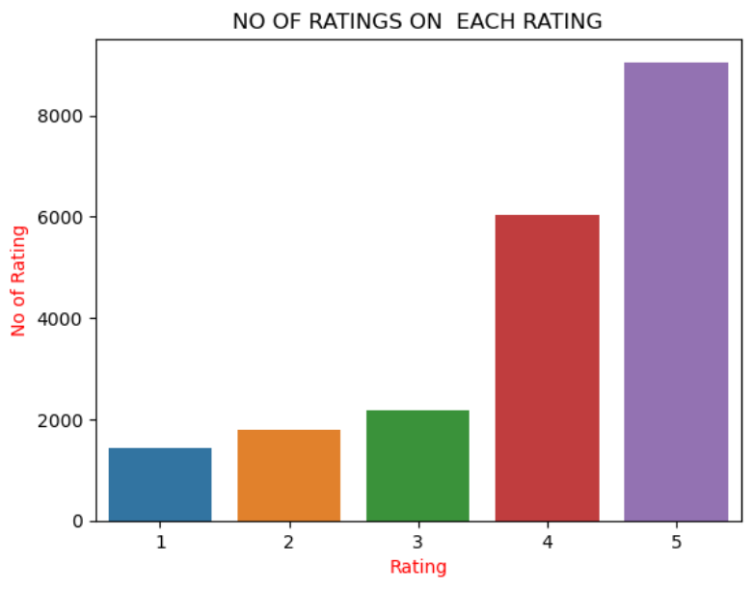
RESULTS
Pic-3: Range of Each Rating
Pic-2: Distribution
Distribution pie chart based on the ratings data from your dataset shows the pic-2.
Each every rating of the customer rating shows the pic-3

